Slide 1

Fraud Detection
BY: Rachana Padaya
Notes:
Hello, good afternoon, my name is Rachana padaya. Today I am presenting my data science project for airline inducsrt. In which I h

Slide 2
Problem Statement
Empowering Financial Security: Detecting Fraudulent Transactions using Advanced Machine Learning Techniques and Predictive Analytics.
Develop a machine learning model to detect potentially fraudulent transactions based on the provided features. The dataset contains information about various transactions, including account age, payment method, time of transaction, and category.
Objective:
The goal is to build a classification model that can accurately classify transactions as either legitimate or potentially fraudulent.

Slide 3
Data Overview
Dataset Size:
Rows: 39,221
Columns: 8
Independent Features: accountAgeDays, numItems, localTime, paymentMethod, paymentMethodAgedays, Category, isWeekend
Target/Dependent Feature: label
Categorical Features: 5
Numerical Features: 3
Missing Values: Out of all the columns — Category and isWeekend — the missing values are 95 and 396, respectively.
Duplicate Values: Dataset have 3033 duplicate data.
Datatype: All columns have valid data types.

Slide 4
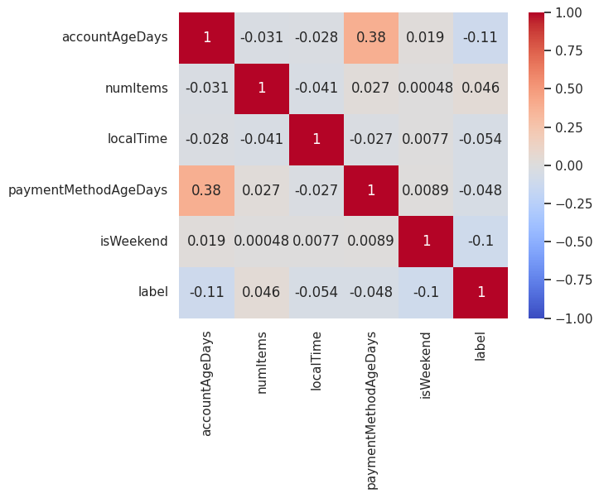
Data Preprocessing
Handling Duplicate Values: I identified and removed duplicate records from the dataset to ensure data quality and maintain the integrity of the analysis.
Handling Missing Values: Since the data does not have many missing values, I used the mode to impute missing values in the categorical features.
Outlier Treatment: I used the IQR (Interquartile Range) method to treat outliers in the localTime and paymentMethodAgeDays features, ensuring the data distribution remained robust and less skewed by extreme values.
Encoding of Categorical data: I used one hot encoding for nominal data.
Data Cleaning: Drop accountAgeDays to prevent data leakage and overfitting, as it clearly separated fraud and legitimate transactions.

Slide 5
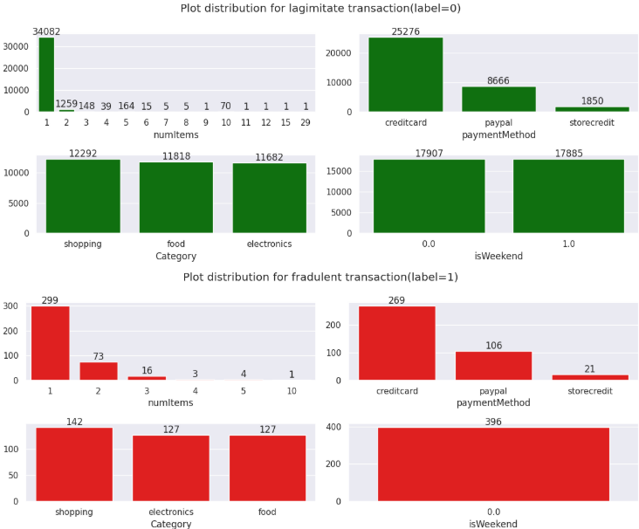
Categorical Features
Represents categories or labels that are discrete and distinct.
Nominal Data: paymentMethod, Category and isWeekend are nominal data, it means we should not give order to segregate its classes.
Ordinal Data: numItems column is ordinal data, it means it has some order to its classes.

Slide 6
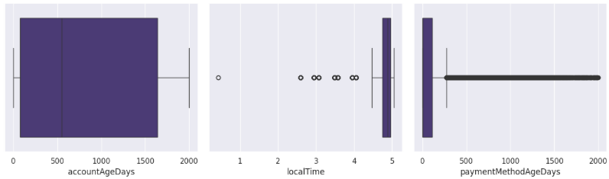
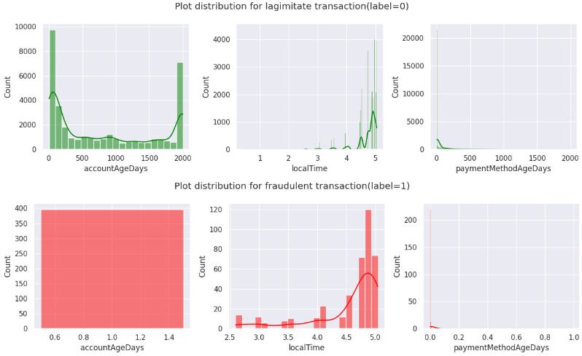
Numerical Features
Represents measurable quantities with a logical order.
Continuous: Can take any value within a range (e.g., height, weight, temperature).
Discrete: Countable values (e.g., number of students, page visits).

Slide 7
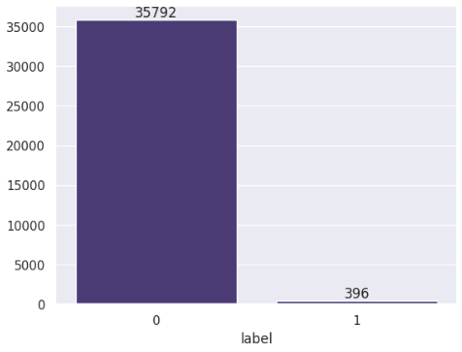
Target Variable Analysis
label is our Target Column.
As target column has two outputs, it is binary classification problem.
Data distribution is 98.9-1.09%.
Can not apply upsampling / downsampling as imbalance is very high with less data.

Slide 8
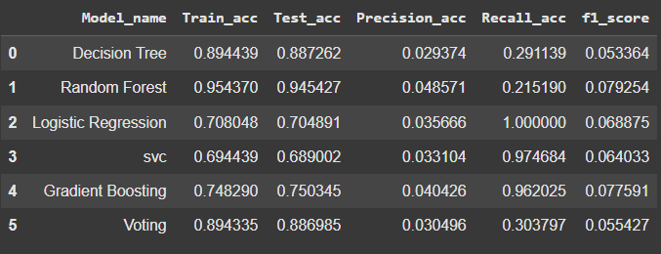
Model Selection
Decision Tree Classifier
Random Forest Classifier (Ensemble)
Voting Classifier (Ensemble)
Gradient Boosting Classifier
Logistic Regression
SVC (Support Vector Classifier)

Slide 9
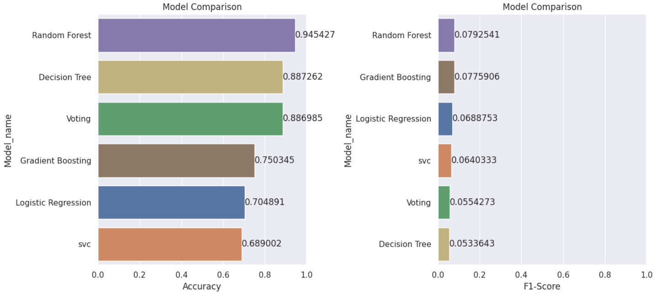
Model Performance Comparison

Slide 10
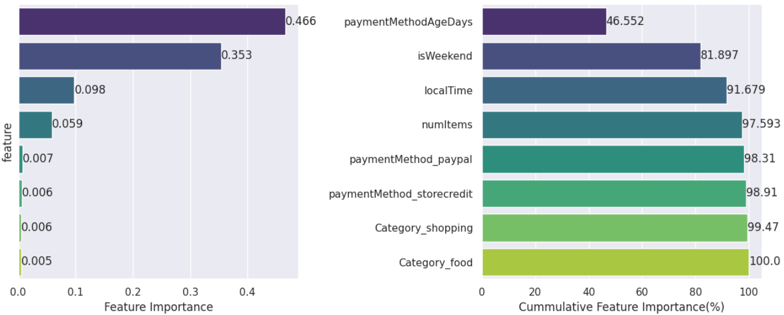
Feature Importance
Out of 8 features 3 of features have 91.6% importance to predict target value.

Slide 11
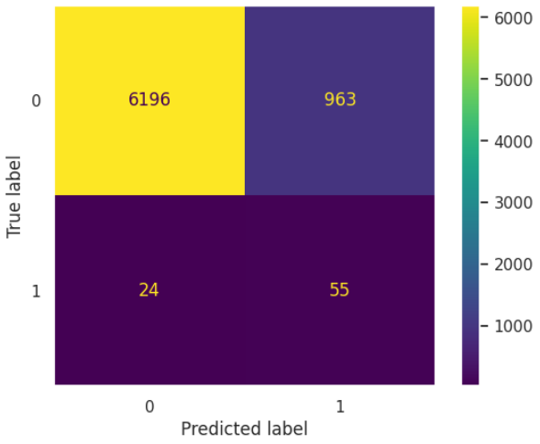
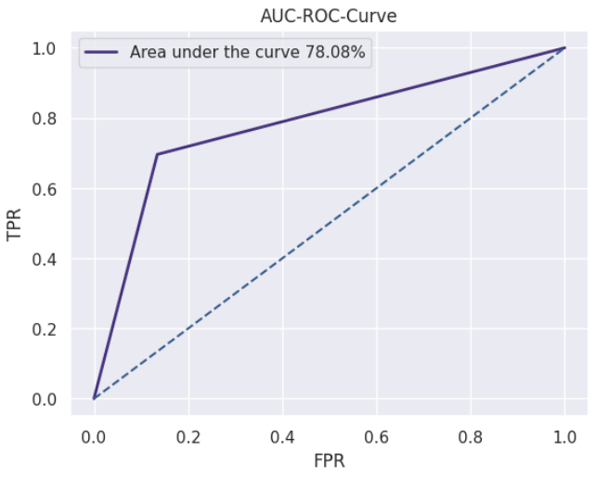
Model Performance of LightGBM Classifier
CONFUSION MATRIX
AUC-ROC CURVE

Slide 12
Conclusion
RandomForestClassifier outperformed all other models as the best tree-based bagging classifier.
After hyperparameter tuning, it showed good recall and low precision without overfitting.
Recall was prioritized to capture more potential fraudulent transactions, even with some false positives.
Model generalized well, with close train-test accuracy.
Top features: paymentMethodAgeDays, isWeekend and localTime.
Achieved an AUC-ROC of 78.08%, indicating decent class separation.

Slide 13
THANK YOU
Would love to answer any questions you might have.

